Slide 1
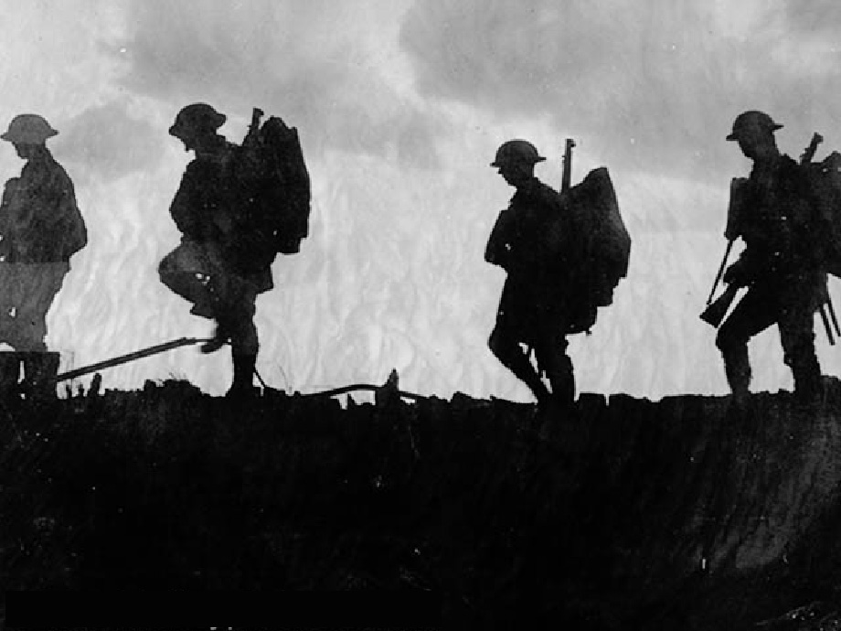
Unit 4: Lecture #3 The Great War
Causes
Of World War I
Notes:
In the summer of 1914, a complex set of circumstances led European nations into the most destructive war the world had ever experienced. Issues of nationalism, imperialism, alliances, and growing militarism were powder kegs waiting to explode. The explosion was triggered by a high profile assassination. The four-year long conflict would dramatically alter the global status quo.
World War I, originally known as “The Great War,” closed the curtain on the old world of the European aristocracies and monarchies while catapulting the United States to the forefront of international politics. The war created new nations and set the stage for conflicts that would rage into the next century.
[image: British troops advance in Allied counterattack]

Slide 2
Lecture Focus Question
How did America’s “sphere of influence” eventually pull it into the Great War?

Slide 3
What were the MAIN Causes of WWI?
Militarism- building up of armed forces, getting ready for war.
Alliances- agreements or promises to defend and help another country.
Imperialism- trying to build up an empire by dominating weaker nations.
Nationalism- having pride in your country and being willing to defend it.

Slide 4
Map of Allied and Central Powers
ALLIED POWERS
Major Powers
British Empire (1914–1918)
France (1914–1918)
Italy (1914–1918)
Russia (1914–1917)
United States (1917–1918)
CENTRAL POWERS
Major Powers
Austria-Hungary (1914–1918)
Germany (1914–1918)
Ottoman Empire/Turkey (1914–1918)
United States
Notes:
The two sides in the Great War were the Allied Powers and the Central Powers. While many other countries were involved, these were the primary players.
ALLIED POWERS:
Major Powers
British Empire (1914–1918)
France (1914–1918)
Italy (1914–1918)
Russia (1914–1917)
United States (1917–1918)
CENTRAL POWERS
Major Powers
Austria-Hungary (1914–1918)
Germany (1914–1918)
Ottoman Empire/Turkey (1914–1918)

Slide 5
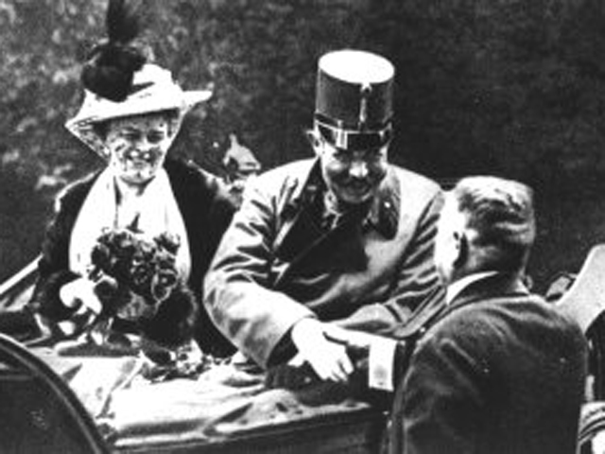
What event starts WWI?
Bosnia was a newly acquired province in the A-H Empire
1914: Archduke Ferdinand, heir to the throne of the Austro-Hungarian Empire is assassinated in Bosnia
Assassination ignites the “Great War”
Assassin was Serbian – Russia had strong ties with Serbia

Slide 6
What series of events unfolded to ignite the Great War?
Serbia
kills Francis Ferdinand heir to the throne
Austria-Hungary w/ Germany’s alliance declares war on Serbia
USA
Is neutral, but is trading with both Great Britain & Germany until…
Great Britain
Allied with France & Belgium declares war on Germany
Russia
defends Serbia and declares war on Austria-Hungary
Germany declares war on neutral Belgium in order to invade
France
allied w/ Russia declares war on Germany
Germany
declares war on Russia

Slide 7
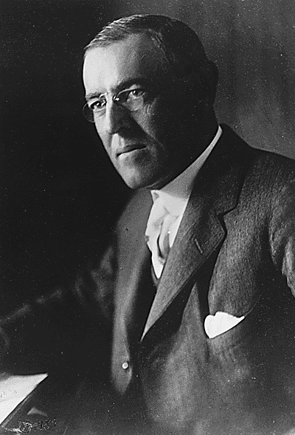
In what ways did the USA respond to the war in Europe?
Neutrality
Propaganda published in British papers swayed public opinion to oppose Germany
But the USA still helped provide 10 billion dollars worth of aid in Liberty Bonds to help the Allies
Preparedness Movement
Peace Movement

Slide 8
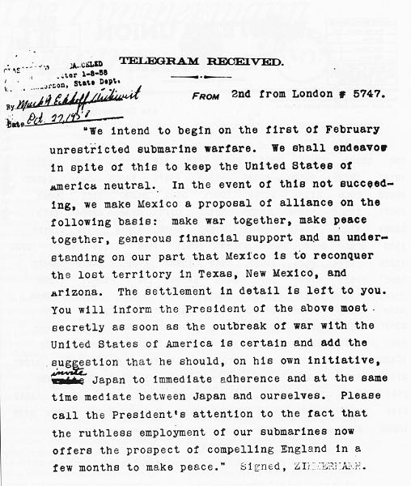
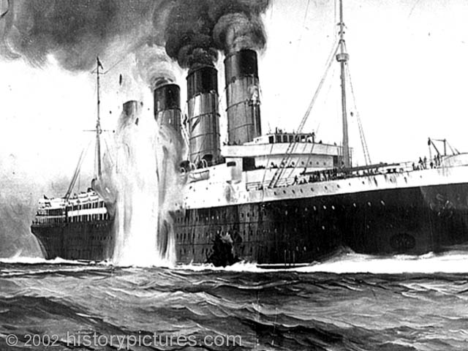
How was the USA drawn into the WWI?
Unrestricted Submarine Warfare
Sinking of the Lusitania
Zimmermann Note
Notes:
Unrestricted Submarine Warfare
U-boat: German submarine
Used to prevent ammunition and supplies from reaching Allied troops
Germany attacked naval and merchant ships, particularly British ships
May 7, 1915: Passenger ship sunk by German submarine
More than 1000 civilian deaths, including 128 Americans
Germany claimed the ship was carrying munitions
The Incident angers Americans and put the U.S. one step closer to entering the war
Zimmerman sent a telegram to Mexico
Intercepted by the British
Secret offer to Mexico
If Mexico declared war on the U.S., Germany would reward it with territory in the American Southwest
Added to the American public’s desire to enter the war

Slide 9
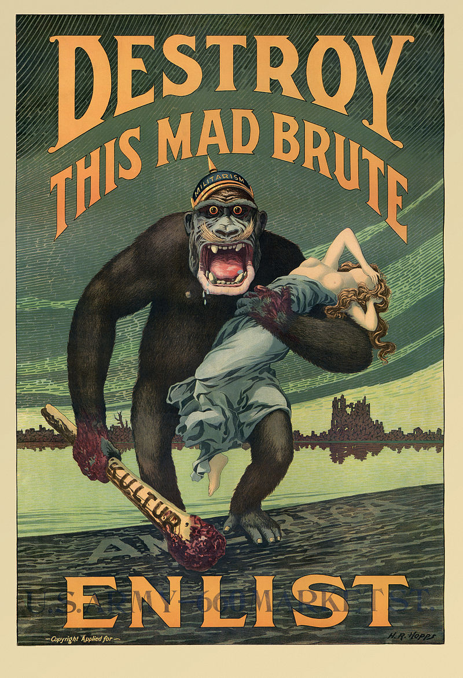
How did America’s melting pot population help keep neutrality and then shift to support Allies?
At first immigrants were loyal to their home lands
Divided between central powers and allied forces.
Unrestricted submarine warfare led Anti German Sentiment
Breakdown in communications led to slanted view in the press in support of the Allies.

Slide 10
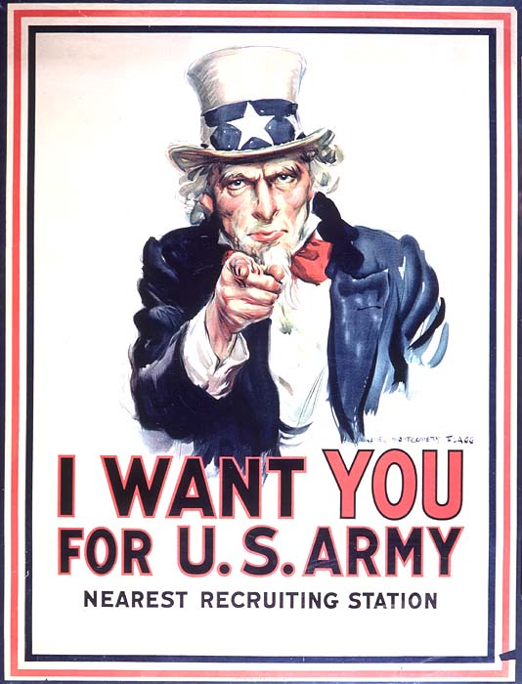
How did Americans Prepare to Fight in WWI?
Selective Service Act
Training for War
The Convoy System
Notes:
#18 The Selective Service Act:
drafted of young men for military service in Europe
#19 Fears of spies and sabotage led to:
Restrictions on Immigration
Repression of free Speech
Discrimination against Germans

Slide 11
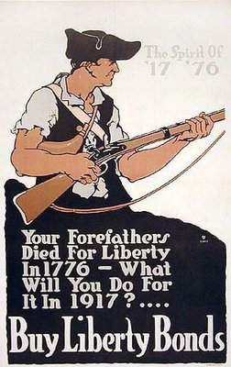
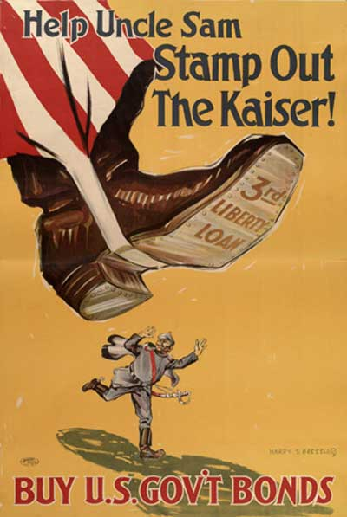
How did the U.S. Government pay for the cost of the War?
Big Government
Financing the War
Managing the Economy
Enforcing Loyalty
Notes:
Big Government
Financing the War
Liberty Bonds
Managing the Economy
New Agencies
Regulating Food & Fuel Consumption
Price Controls
Rationing
Daylight Savings Time?
Enforcing Loyalty
Fear of Foreigners
Hate the HUN!
Repression of Civil Liberties
Controlling Political Radicals
17 The Sedition Act:
Made it illegal to discuss anything negative about the war or the US govt.

Slide 12
How would Americans be involved?
In 1917 U.S. infantry troops landed in France to begin training for combat.
After four years of bloody stalemate along the western front, America’s well-supplied military caused a major turning point in the war and helped the Allies to victory.
When the war finally ended, on November 11, 1918, more than two million American soldiers had served on the battlefields of Western Europe, and some 50,000 of them had lost their lives

Slide 13
Lecture Review Questions
What were the elements that caused WWI?
How did WWI Start?
What 2 events brought the USA closer to war?
Why did the USA try to remain neutral , but eventually join the Allies in WWI?
What was the Convoy system and why was it important to the Allies?
How did the US pay for WWI and why did they fund it publically?

